Slide 1

Recommender System Study Case
Débora Santos - 20200748 Pedro Medeiros - 20200742 Rebeca Pinheiro - 20201096

Slide 2
BACKGROUND
BUSINESS GOAL
Implement a recommender system.
Cold start problem: offer relevant products to new customers.
SUCESS CRITERIA
ManyGiftsUK
Increase on sales
Improve customer satisfaction

Slide 3
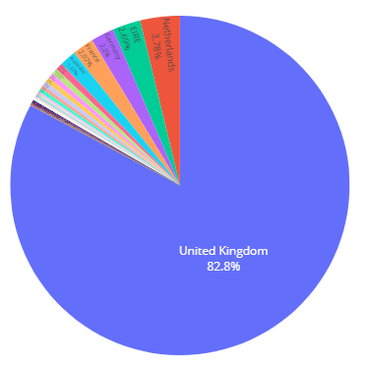
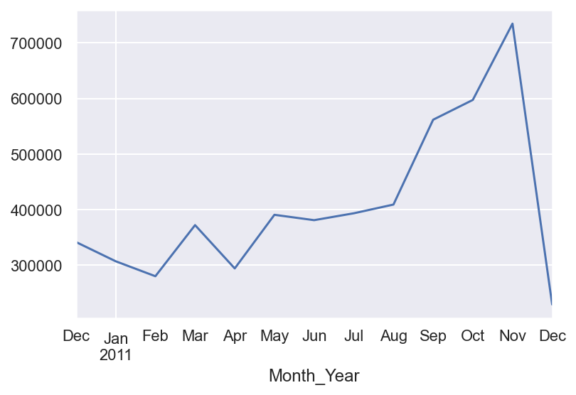
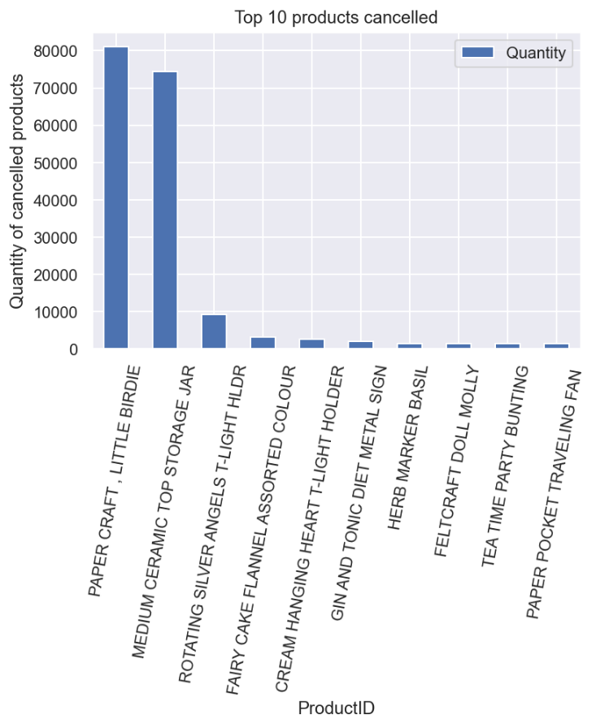
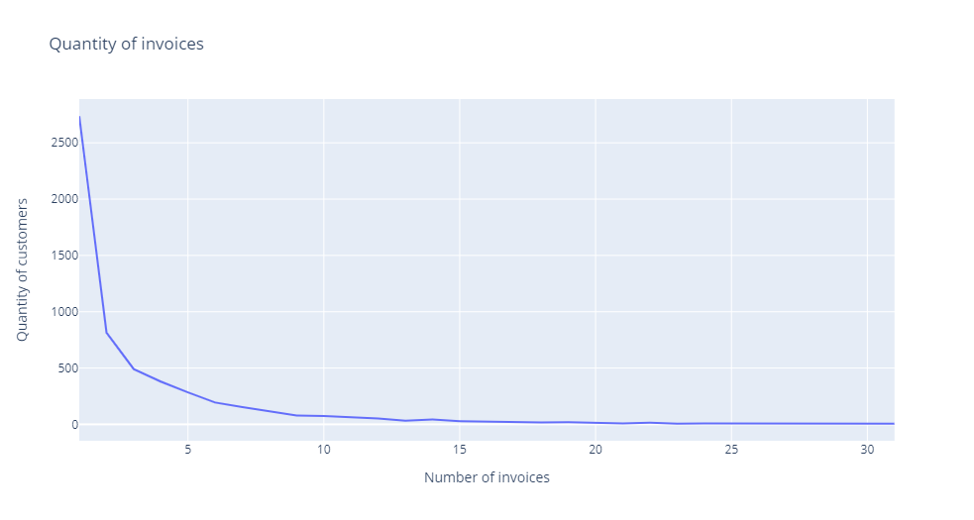
KEY FINDINGS
The period with most purchased is from September-November
UK represents more than 80% of the sales volume
The most canceled item is PaperCraft followed by Medium Ceramic
Most customers buy only one order and few of them bought more than 15 times.

Slide 4
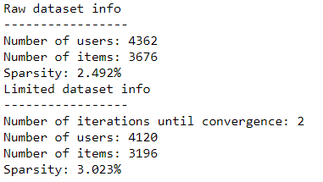
PROJECT PLAN
Data Preparation:
Remove duplicates observations
Eliminate StockCode items which didn’t fit the proposed format
Remove items which price were equal 0
2% removed of total data
Feature Engineering:
Only one new variable created: Month-Year.
For missing CustomerID there were created a fake customer id number, according the invoice number to analyse the sales. To recommendations, they were treated as a new customer.
Modelling:
Reduce sparsity
Grouped the data according with the quantity (Level confidence) and removed items/users with quantity = 0
Create 2 sparse matrices
Split training and test data (20%) – Masked data.
Fit the models: ALS, LMF and BPR
HyperParameter tunning
Evaluation:
AUC Metric
Analysis of recommendations

Slide 5
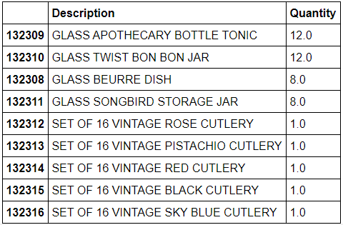
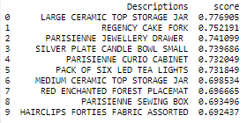
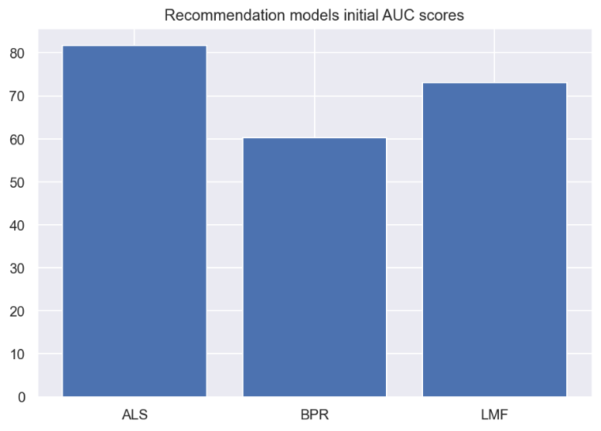
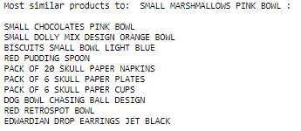
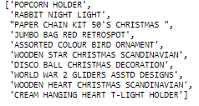

RESULTS
Recommendations
A user's most purchased products
Recommended products
Algorithm
Final: AlternatingLeastSquares
Finding similar items
Cold Start – New users

Slide 6
KEY TAKEAWAYS
Results: The model presents an AUC of 80%, that means the model properly predicts recommendations 80% of the times.
Cold Start Problem: Recommendations will be made according to the location of the customer.
Next Step: Implement the recommender system on the website.
Suggestions:
Collect customer preferences to improve the recommendations of new customers
More data about products attributes.

